Slide 1

Comparison of Region Based on Sales Dashboard using Tableau
SUBMITTED BY: EPSA KAPUR

Slide 2
Table of Contents
Objective
Description
Problem Statement & Motivation
Tasks
Datasets and Steps Taken
Key Findings

Slide 3
Objective
Help the organization by creating a dashboard to visualize the sales comparison between two selected regions.

Slide 4

Description
The director of a leading organization wants to compare the sales between two regions. He has asked each region’s operators to record the sales data to compare by region. The upper management wants to visualize the sales data using a dashboard to understand the performance between them and suggest the necessary improvements.

Slide 5
PROBLEM STATEMENT & MOTIVATION
To create a dashboard to understand the performance of the sales between two regions – Central Region and East Region
The created dashboard should be a win win for the student, institute, and corporate.

Slide 6

TASKS
Compare two regions Central Region and East Region by creating a Dashboard
Partition the dashboard to display the details of the Central region and East region.
First Order Date
Total Sales
Average Sales per Order
No. of Customers
No. of Orders
No. of Products in Sale

Slide 7
DATASETS
Sample Superstore using Github Link
Link to Github

Slide 8
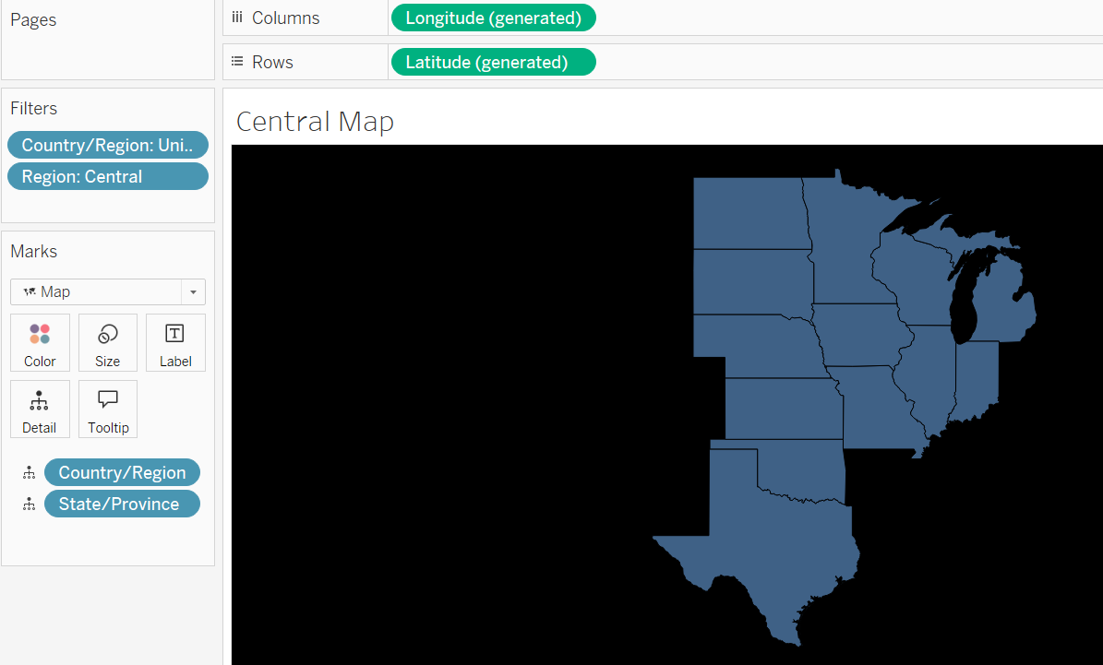
STEPS TAKEN
Dashboard comprises of 10 sheets which are explained as follows:
Central Map Sheet
Filled map is used to build this sheet and it comprises of Country/Region, State/Province.
A filter for Country/Region as United States is applied.
Another filter for Region as Central is applied.
To make the background of the filled map from white to dark (eg black), changes are applied to the background layers through the Map option.

Slide 9
STEPS TAKEN
Central Top View Sheet - It comprises of the following fields:
First Order Date
Total Sales
Average Sales per Order
No. of Customers
No. of Orders
No. of Products in Sale

Slide 10
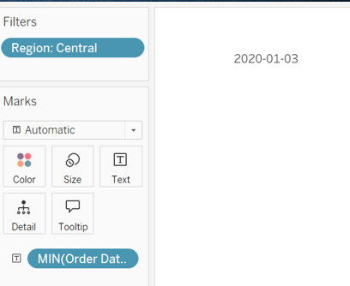
STEPS TAKEN
First Order Date of Central Region
Added Order Date to the Text mark and selected exact date
Added a Filter for Region as Central
First Order Date can also be taken as Minimum Order Date and for that measure used is Minimum.

Slide 11
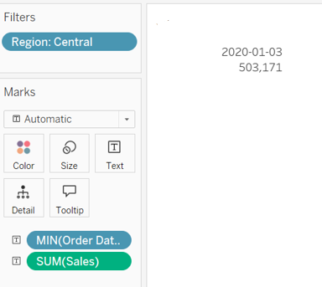
STEPS TAKEN
Total Sales of Central Region
Added Sales to the Text Mark

Slide 12
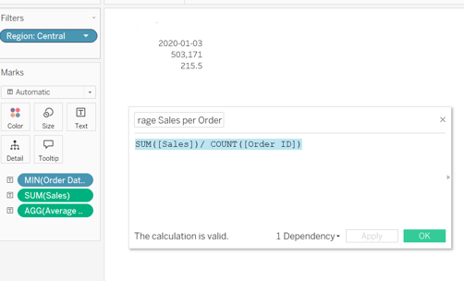
STEPS TAKEN
Average sales per order of Central Region
A new calculated field named Average sales by Order is created which is SUM([Sales])/ COUNT([Order ID])

Slide 13

STEPS TAKEN
No of Customers, Orders and Products
Customer name is added to the Text mark and the measure used is Count (Distinct) to get the unique number of customers
Order ID is added to the Text mark and the measure used is Count (Distinct) to get the unique number of orders
Product Name is added to the Text mark and the measure used is Count (Distinct) to get the unique count of products

Slide 14
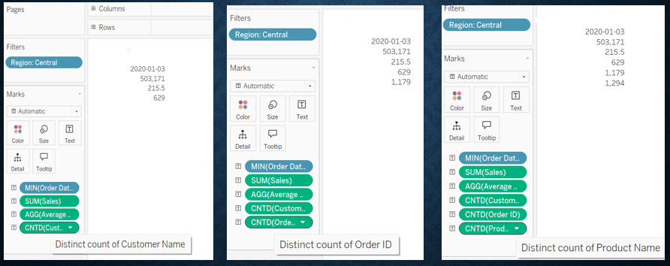
STEPS TAKEN

Slide 15
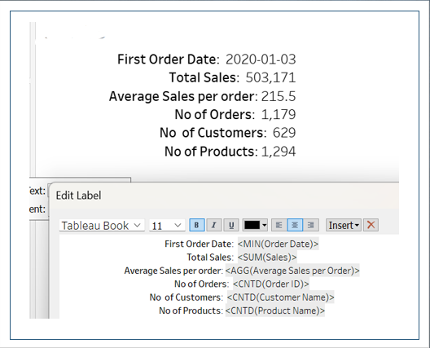
STEPS TAKEN
The Text labels are then renamed as shown in the image in the Central Top View Sheet

Slide 16
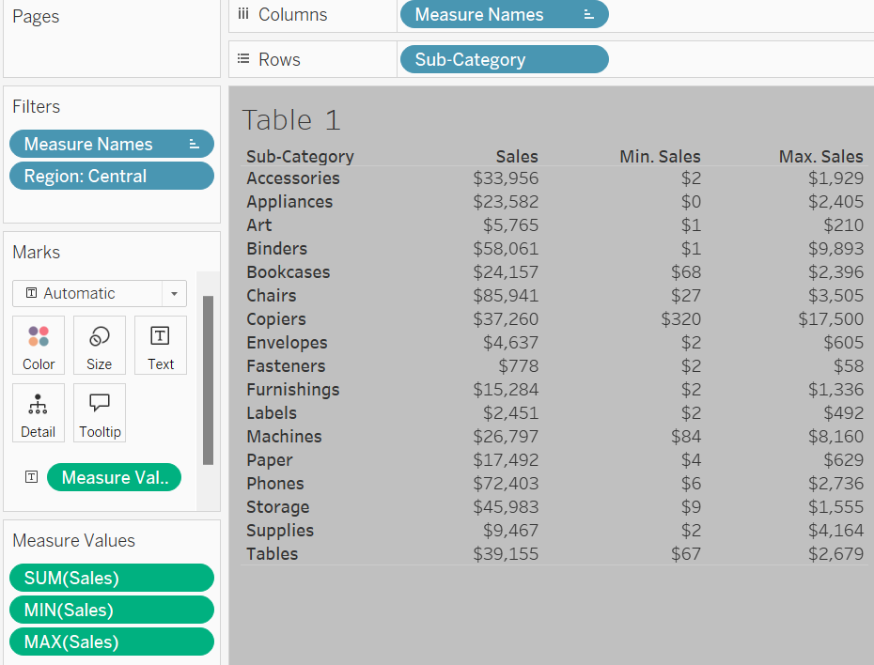
STEPS TAKEN
For the bottom of the Central Region Dashboard, it is split into 3 sections which includes Table 1, Table 2, and Table 3 sheets
Table 1 Sheet – It includes Sub-Category, Total Sales, Minimum Sales and Maximum Sales in a tabular form.

Slide 17
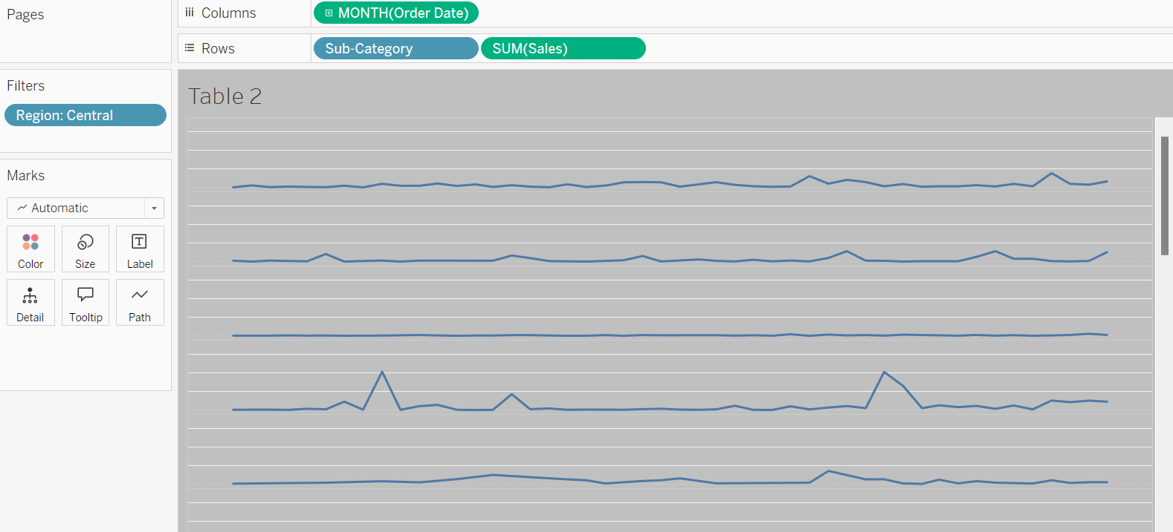
STEPS TAKEN
Table 2 Sheet –It includes Order Date and Sales represented using line chart where year is added Month year and thereafter subcategory is dragged into rows to see the entire chart.

Slide 18
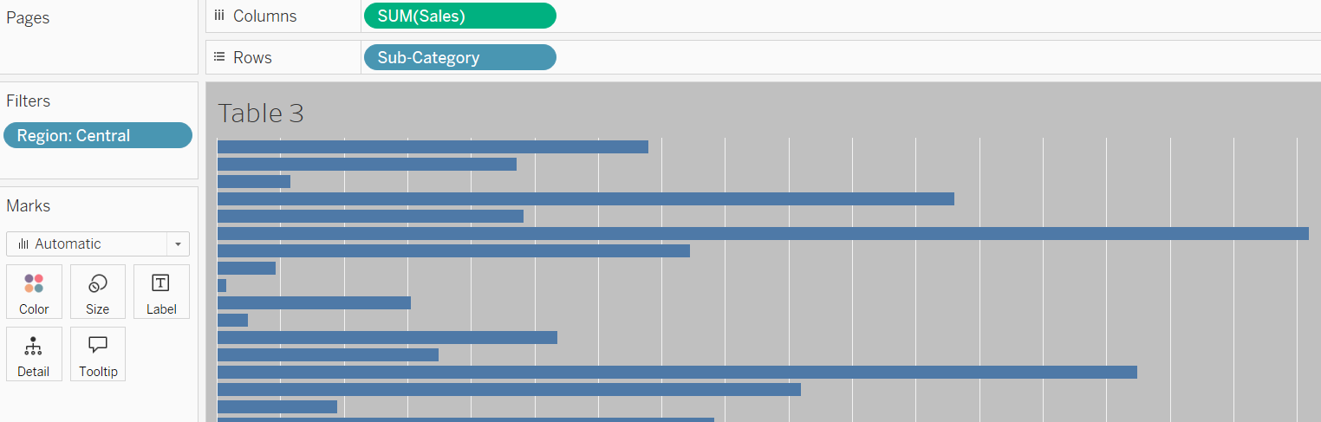
STEPS TAKEN
Table 3 Sheet – It includes Sub-Category and Sales represented using the horizontal bar chart.

Slide 19
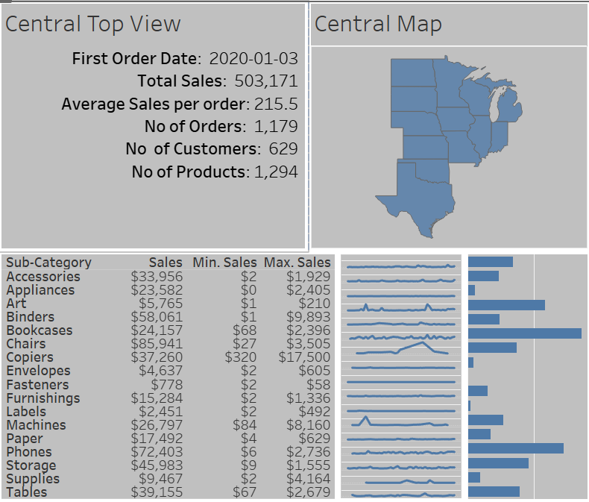
STEPS TAKEN
Once all the sheets are prepared for the Central Region, Dashboard for the Central Region is built by combining the sheets into horizontal and vertical containers.

Slide 20
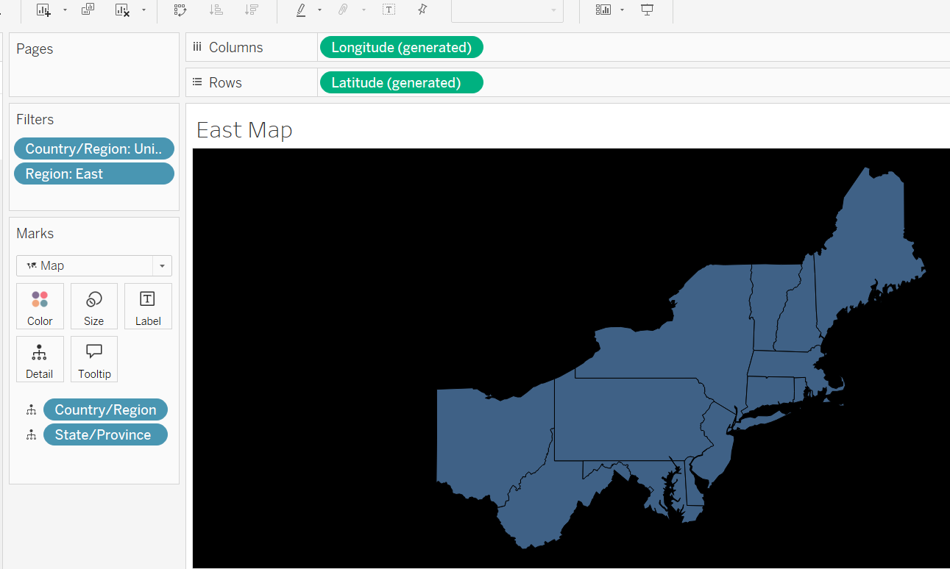
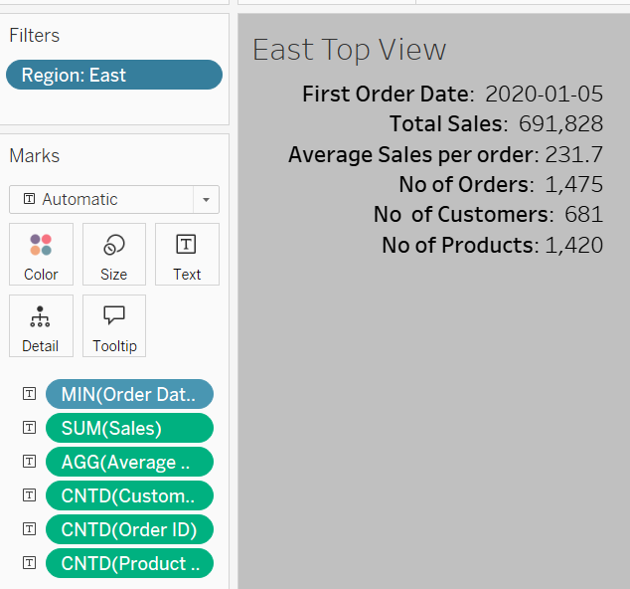
STEPS TAKEN
For East Region, same steps are performed except for the Region filter which is replaced by the East region

Slide 21
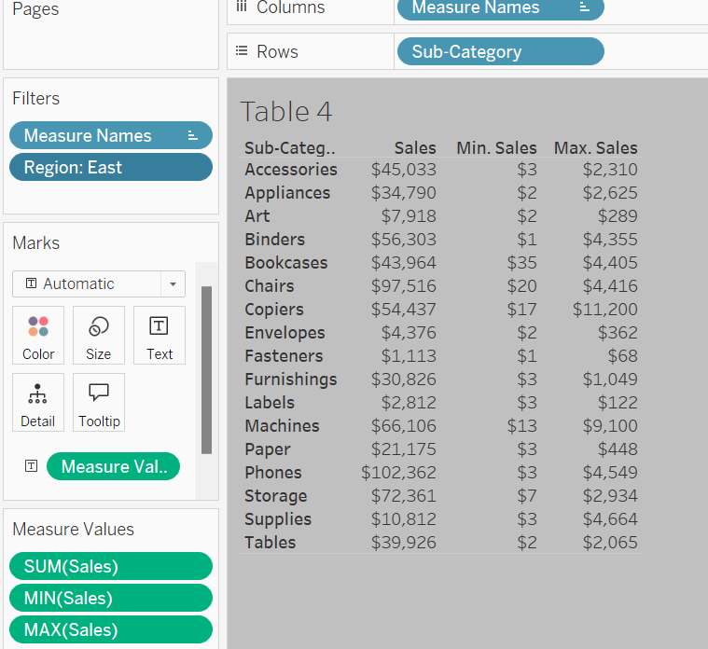
STEPS TAKEN
For the bottom of the East Region Dashboard, it is split into 3 sections which includes Table 4, Table 5, and Table 6 sheets
Table 4 Sheet – It includes Sub-Category, Total Sales, Minimum Sales and Maximum Sales in a tabular form.

Slide 22
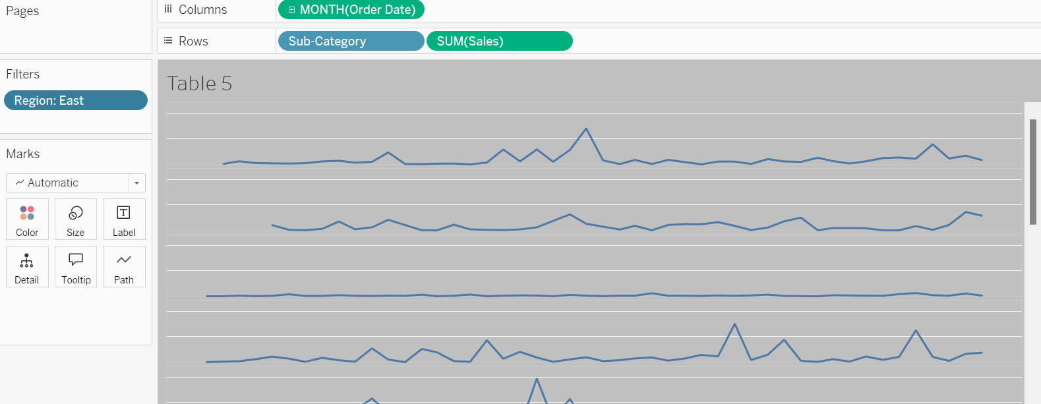
STEPS TAKEN
Table 5 Sheet –It includes Order Date and Sales represented using line chart where year is added Month year and thereafter subcategory is dragged into rows to see the entire chart.

Slide 23
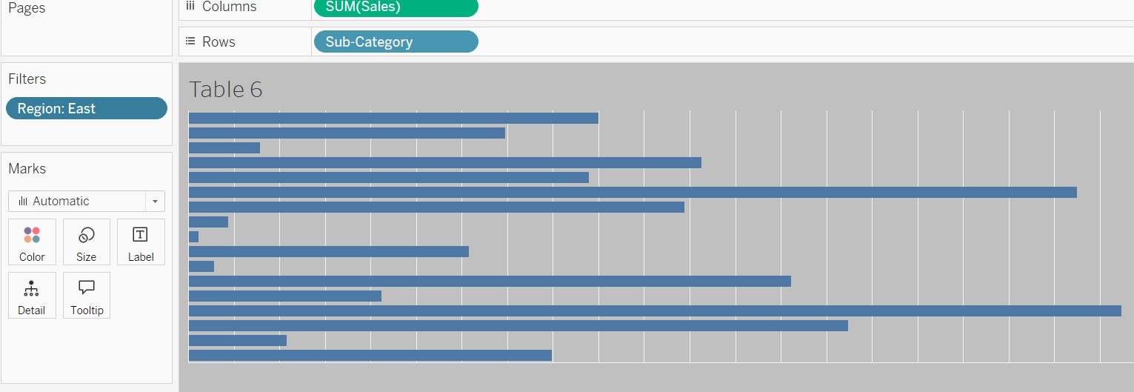
STEPS TAKEN
Table 6 Sheet – It includes Sub-Category and Sales represented using the horizontal bar chart.

Slide 24
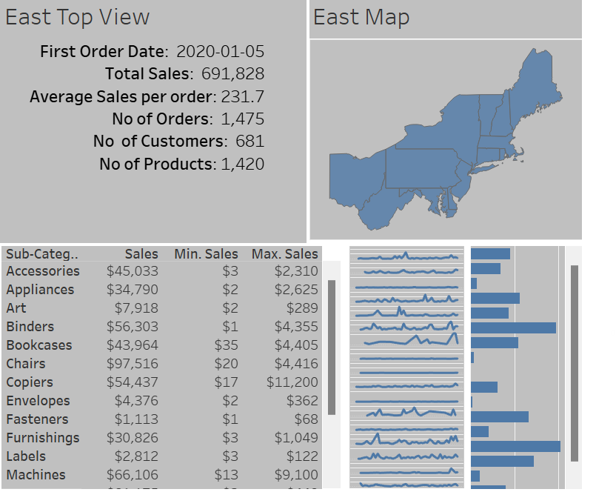
STEPS TAKEN
Once all the sheets are prepared for the East Region, Dashboard for the East Region is built by combining the sheets into horizontal and vertical containers.

Slide 25
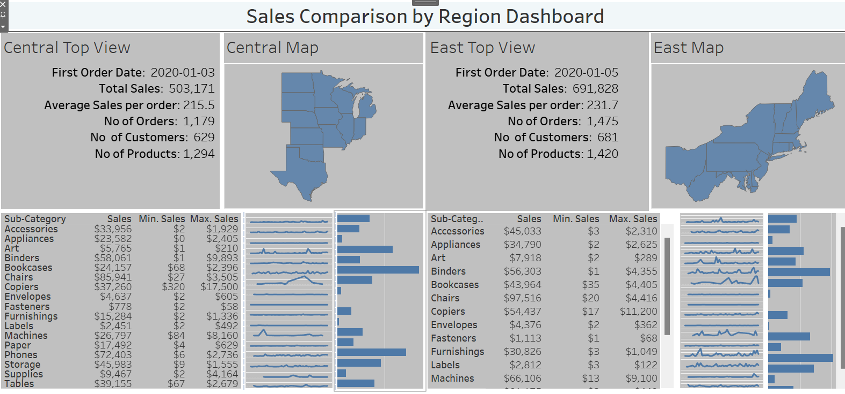

Slide 26
Key findings
Total Sales for East Region > Total Sales for Central Region
Sum of Sales was highest for Chairs subcategory for Central Region whereas Sum of Sales was highest for Phones subcategory for East Region

Slide 27
THANK YOU

